Slide 1
Text Analysis
Digital Humanities

Slide 2
Stuff to think about...
What is text?
What questions can we ask of text?
Who uses text analysis?
What are its applications?
What are its limitations?

Slide 3
What is text analysis?
Text analysis is also known as text mining and text analytics.
Text analysis is the discovery by computer of new, previously unknown information, by automatically extracting information from different written resources.
A key element is the linking together of the extracted information to form new facts or new hypotheses to be explored further by more conventional means of experimentation and research.

Slide 4
What is text analysis?
Text analysis or mining is different from what we're familiar with in web search.
In a search, the user is typically looking for something that is already known and has been written by someone else.
The problem is pushing aside all the material that currently isn't relevant to your needs in order to find the relevant information.
In text analysis, the goal is to discover heretofore unknown information, something that no one yet knows and so could not have yet written down.

Slide 5
Text analysis v. data mining
Text analysis is a variation on a field called data mining, which tries to find interesting patterns from large databases.
A typical example in data mining is using consumer purchasing patterns to predict which products to place close together on shelves, or to offer coupons for, and so on. For example, if you buy a flashlight, you are likely to buy batteries along with it.
A related application is automatic detection of fraud, such as in credit card usage. Analysts look across huge numbers of credit card records to find deviations from normal spending patterns. A classic example is the use of a credit card to buy a small amount of gasoline followed by an overseas plane flight. The claim is that the first purchase tests the card to be sure it is active.

Slide 6
Text analysis v. data mining
The difference between regular data mining and text mining is that in text mining the patterns are extracted from natural language text rather than from structured databases of facts.
Databases are designed for programs to process automatically; text is written for people to read. We do not have programs that can "read" text and will not have such for the foreseeable future. Many researchers think it will require a full simulation of how the mind works before we can write programs that read and interpret text the way people do.

Slide 7
Computational linguistics
However, there is a field called computational linguistics (also known as natural language processing) which is making a lot of progress in doing small subtasks in text analysis.
For example, it is relatively easy to write a program to extract phrases from an article or book that, when shown to a human reader, seem to summarize its contents.
(The most frequent words and phrases in this PowerPoint, minus the really common words like "the" are: text analysis, information, programs, and example, which is not a bad five-word summary of its contents.)

Slide 8
Text extraction
There are programs that can, with reasonable accuracy, extract information from text with somewhat regularized structure. For example, programs that read resumes and extract out people's names, addresses, job skills, and so on, can get accuracies from 80 to 90% or better.
This is really information extraction, not text analysis. True text analysis discovers new pieces of knowledge, using approaches that find overall trends in textual data.

Slide 9
Text analysis v. extraction
An analogy I like to use comes from the realm of crime fighting. I think discovering new knowledge vs. showing trends is like the difference between a detective following clues to find the criminal vs. analysts looking at crime statistics to assess overall trends in car theft.
People are using the output of such programs to try to link together information in interesting ways. For example, one can extract all the names of people and companies that occur in text-based news (e.g. newspapers, blogs, websites, etc.) surrounding the topic of wireless technology to try to infer who the players are in that field. There are a number of companies that are investigating this kind of application.

Slide 10
Text analysis v. extraction
One problem with these approaches is that it is difficult to recognize which of the many relations that are shown are truly interesting.
You'll immediately see who the big players are, but anyone who knows the business will already be aware of this.
You'll also see many, many weak links between various players, even hundreds or thousands of such links, and you can't tell which are the really interesting ones that you should pay attention to.

Slide 11
Text analysis development
To get farther though we need more sophisticated language analysis. A number of researchers are working on statistical techniques that try to assign semantics, or meaning, to parts of the text.
They break off pieces of the problem of analysis, targeted towards particular applications, rather than trying to "read" the articles as a whole.

Slide 12
Limitations of text analysis
The fundamental limitations of text analysis are first, that we will not be able to write programs that fully interpret text for a very long time, and second, that the information one needs is often not recorded in textual form.
If I tried to write a program that detected when and where a new word came into existence, and how it spread by analyzing web pages, I would miss important clues relating to usage in spoken conversations, email, on the radio and TV, and so on.
Similarly, if I tried to write a program that processes published documents in order to guess what will happen to a bill in Washington DC, I would fail because most of the action still happens in negotiations behind closed doors.

Slide 13
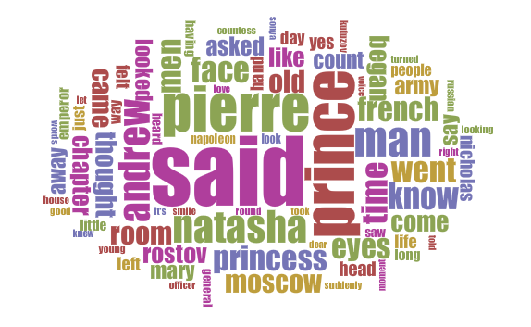
Voyant
Notes:
http://www.gutenberg.org/cache/epub/2600/pg2600.txt
„Russia“ appears 173 times

Slide 14
Examples of Voyant in Research
Voyant Examples:
http://docs.voyant-tools.org/about/examples-gallery/

Slide 15
Using Voyant
Voyant homepage:
https://voyant-tools.org/
Voyant help page:
http://docs.voyant-tools.org/start/

Slide 16
More DH-specific tools
Overviews of 71 tools for Digital Humanists
Simpson, J., Rockwell, G., Chartier, R., Sinclair, S., Brown, S., Dyrbye, A., & Uszkalo, K. (2013). Text Mining Tools in the Humanities: An Analysis Framework. Journal of Digital Humanities, 2 (3), http://journalofdigitalhumanities.org/2-3/text-mining-tools-in-the-humanities-an-analysis-framework/

Slide 17
Tools (powerful, but require some computing experience)
Ling Pipe
linguistic processing of text including entity extraction, clustering and classification, etc.
http://alias-i.com/lingpipe/
OpenNLP
the most common NLP tasks, such as POS tagging, named entity extraction, chunking and coreference resolution.
http://opennlp.apache.org/
Stanford Parser and Part-of-Speech (POS) Tagger
http://nlp.stanford.edu/software/tagger.shtm/
NTLK
Toolkit for teaching and researching classification, clustering and parsing
http://www.nltk.org/
OpinionFinder
subjective sentences, source (holder) of the subjectivity and words that are included in phrases expressing positive or negative sentiments.
http://code.google.com/p/opinionfinder/
Basic sentiment tokenizer plus some tools, by Christopher Potts
http://sentiment.christopherpotts.net
Twitter NLP and Part-of-speech tagging
http://www.ark.cs.cmu.edu/TweetNLP/
Notes:
Add

Slide 18

Next class…
Image and video analysis

